Slide 1

ZEN Blue Image Analysis - Mitochondria Segmentation
APAC Digital Solutions
Microsoft Automation and Image Analysis Trainee
2020-11-24

Slide 2
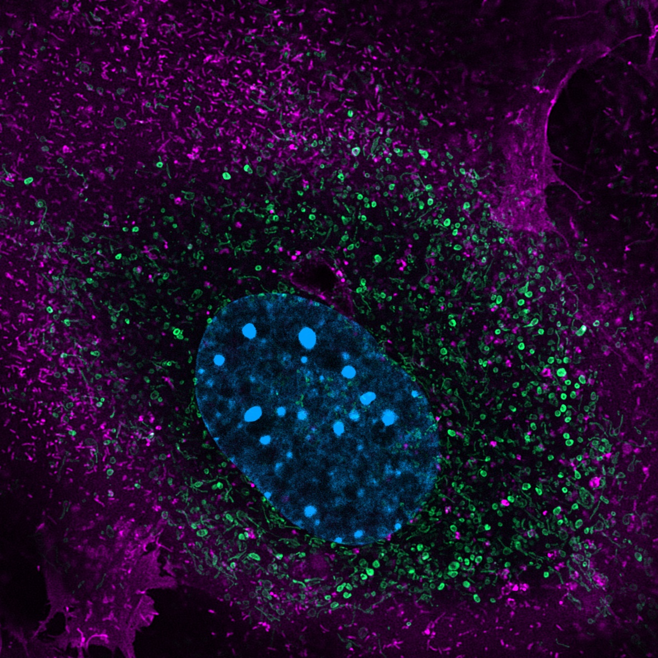
Sample Input Image
Input Image

Slide 3
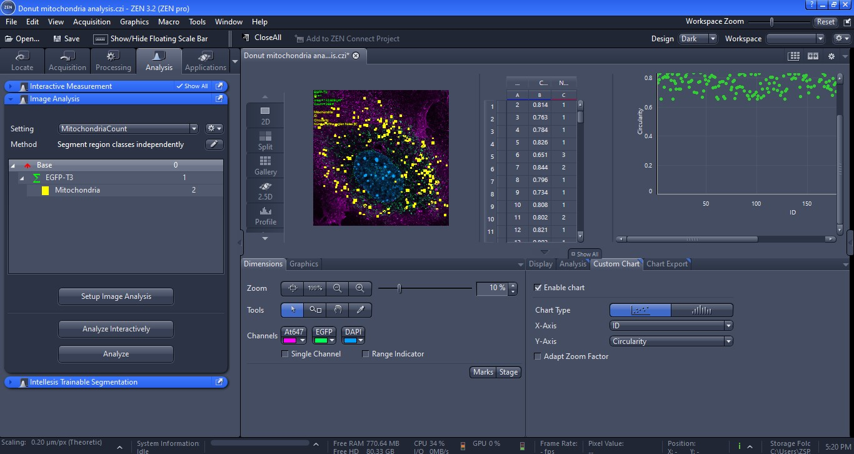
Analyzed Output The input image was initially processed using an unsharp mask, segmented using global threshold and then followed by a morphological Opening operation. Circularity (0.7 to 1) and number of holes (1 to 100) conditions were then imposed to segment the donut-shaped mitochondria.
Analyzed Output

Slide 4
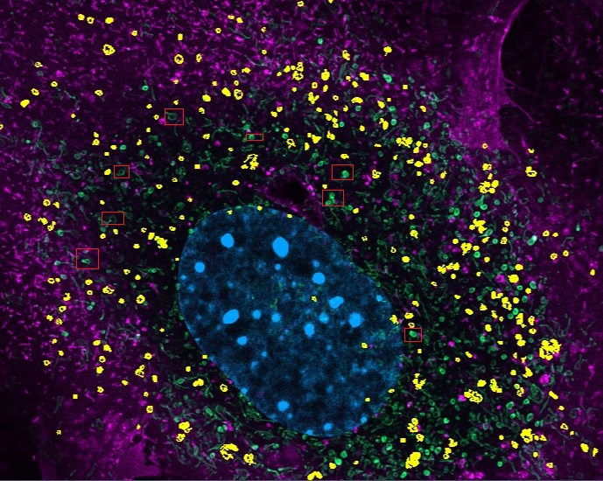
Output segmented Image
Note : Some donut-shaped mitochondria missed (marked in red boxes). This may be overcome using Interactive Image Segmentation in ZEN Blue
Snapshot of output segmented Image

